Slide 1
Constituency Grammars

Slide 2
Context-free grammars
CFGS the backbone of many formal models of the syntax of natural language (and, for that matter, of computer languages).
they play a role in many computational applications, including grammar checking, semantic interpretation, dialogue understanding, and machine translation.
express sophisticated relations among the words in a sentence, yet computationally tractable enough that efficient algorithms exist for parsing sentences with them

Slide 3
Constituency
Syntactic constituency is the idea that groups of words can behave as single units, or constituents.
For example, group of words come together to form a Noun Phrase.
Part of developing a grammar involves building an inventory of the constituents in the language.

Slide 4

How do words group together in English?
Consider noun phrase the noun phrase, a sequence of words surrounding at least one noun.
Here are some examples of noun phrases

Slide 5
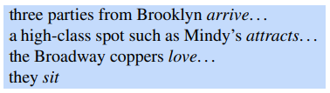
How do words group together in English?
How these words for constituents or they group together ?
One evidence is that they can all appear in similar syntactic environments, for example, before a verb.

Slide 6

But while the whole noun phrase can occur before a verb, this is not true for each of the individual words that make up a noun phrase.
The following are not grammatical sentences of English (we use an asterisk (*) to mark fragments that are not grammatical English sentences):

Slide 7


Pre-posed or post-posed constructions
For example, the prepositional phrase on September seventeenth can be placed in a number of different locations in the following examples, including at the beginning (preposed) or at the end (postposed):
But again, while the entire phrase can be placed differently, the individual words making up the phrase cannot be

Slide 8
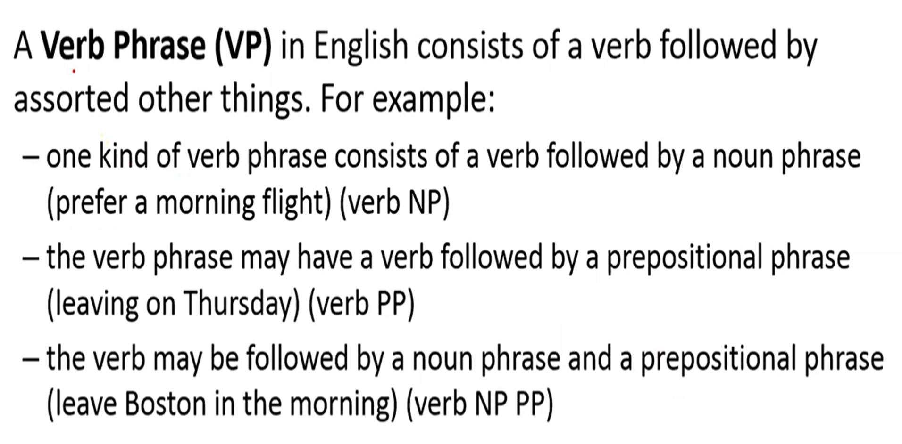
Verb Phase

Slide 9
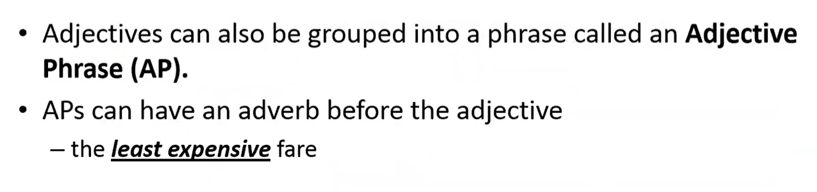
Adjective Phrase

Slide 10
Context-Free Grammars
formal system for modeling constituent structure in English and other natural languages is the Context-Free Grammar, or CFG.
It is also called Phrase-Structure Grammars

Slide 11

Context-Free Grammars
A context-free grammar consists of a set of rules or productions
Which expresses the ways that symbols of the language can be grouped and ordered together, and a lexicon of words and symbols
Following is the Example of production rules of - CFG

Slide 12

Context-free Grammars
Context-free rules can be hierarchically embedded, so we can combine the previous rules with others, like the following, that express facts about the lexicon:

Slide 13
Symbols in CFG
symbols that are used in a CFG are divided into two classes
Terminal non-terminal
The symbols
terminal that correspond to words in the language (“the”, “nightclub”)
symbols that express abstractions over these terminals are called non-terminals.
the item to the right of the arrow (→) is an ordered list of one or more terminals and non-terminals;
to the left of the arrow is a single non-terminal symbol expressing some cluster or generalization.

Slide 14
Two ways of CFG
a device for generating sentences and
a device for assigning a structure to a given sentence.

Slide 15
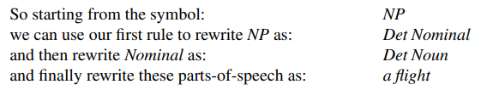
CFG as a generator
we can read the → arrow as “rewrite the symbol on the left with the string of symbols on the right”.
a flight can be derived from the non-terminal NP

Slide 16
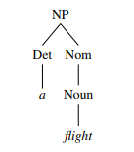
CFG as a generator
Thus, a CFG can be used to generate a set of strings. ]
This sequence of rule expansions is called a derivation of the string of words.
It is common to represent a derivation by a parse tree (commonly shown inverted with the root at the top).
Figure above “A parse tree for “a flight”” shows the tree representation of this derivation

Slide 17
Start Symbol
The formal language defined by a CFG is the set of strings that are derivable start symbol from the designated start symbol.
Each grammar must have one designated start symbol, which is often called S.
Since context-free grammars are often used to define sentences, S is usually interpreted as the “sentence” node, and the set of strings that are derivable from S is the set of sentences in some simplified version of English.

Slide 18
Few additional rules
The following rule expresses the fact that a sentence can consist of a noun phrase followed by a verb phrase:verb phrase
S → NP VP I prefer a morning flight
A verb phrase in English consists of a verb followed by assorted other things;for example, one kind of verb phrase consists of a verb followed by a noun phrase:
VP → Verb NP prefer a morning flight

Slide 19
Few additional rules
the verb may be followed by a noun phrase and a prepositional phrase:
VP → Verb NP PP leave Boston in the morning
the verb phrase may have a verb followed by a prepositional phrase alone:
VP → Verb PP leaving on Thursday
A prepositional phrase generally has a preposition followed by a noun phrase.
For example, a common type of prepositional phrase in the ATIS corpus is used to indicate location or direction:
PP → Preposition NP from Los Angeles

Slide 20
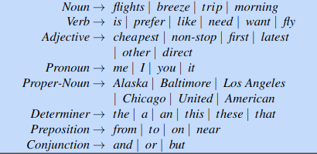
Example of lexicons

Slide 21
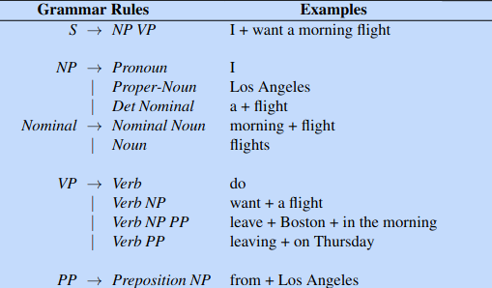
The grammar for L0, with example phrases for each rule

Slide 22
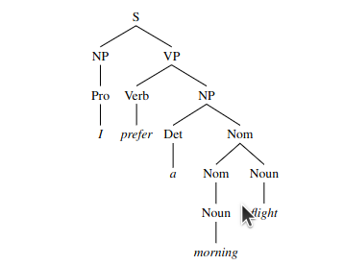
The parse tree for “I prefer a morning flight” according to grammar L0

Slide 23
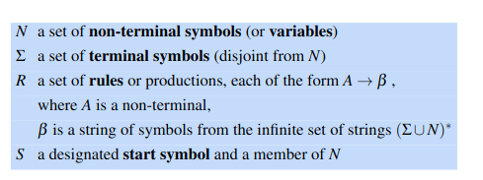
Formal Definition of Context-Free Grammar
A context-free grammar G is defined by four parameters: N, Σ, R, S (technically this is a “4-tuple”).
The problem of mapping from a string of words to its parse tree is called syntactic parsing;

Slide 24
Constituency Parsing
Syntactic parsing is the task of assigning a syntactic structure to a sentence
Parse trees can be used in applications such as grammar checking sentence that cannot be parsed may have grammatical errors (or at least be hard to read).
Parse trees can be an intermediate stage of representation for semantic analysis

Slide 25
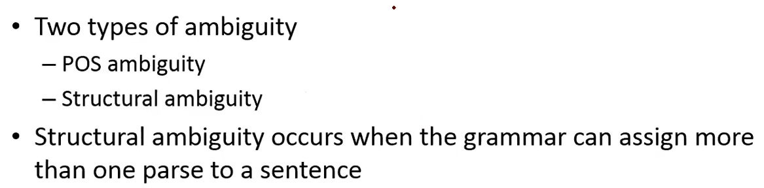
Ambiguity

Slide 26
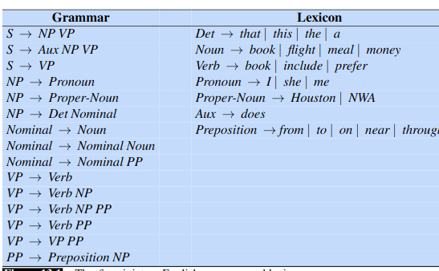

Slide 27
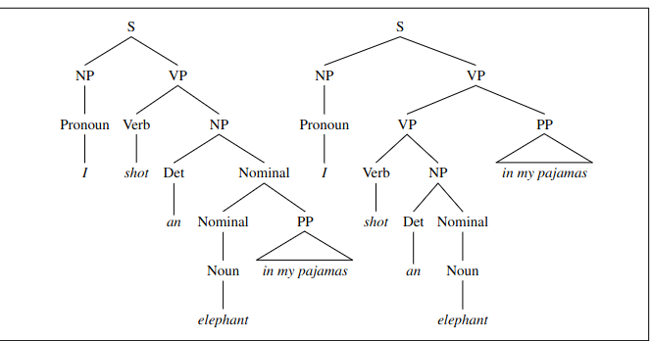

Slide 28
Explanantion
Two parse trees for an ambiguous sentence.
The parse on the left corresponds to the humorous reading in which the elephant is in the pajamas,
the parse on the right corresponds to the reading in which Captain Spaulding did the shooting in his pajamas

Slide 29
Types of ambiguity
Two common kinds of ambiguity are attachment ambiguity and coordination ambiguity.
attachment ambiguity
coordination ambiguity
A sentence has an attachment ambiguity if a particular constituent can be attached to the parse tree at more than one place.
The Groucho Marx sentence is an example of PP-attachment ambiguity. Various kinds of adverbial phrases are also subject to this kind of ambiguity.
For instance, in the following example the gerundive-VP flying to Paris can be part of a gerundive sentence whose subject is the Eiffel Tower or it can be an adjunct modifying the VP headed by saw:
We saw the Eiffel Tower flying to Paris.
In coordination ambiguity phrases can be conjoined by a conjunction like and coordination ambiguity
For example, the phrase old men and women can be bracketed as [old [men and women]], referring to old men and old women, or as [old men] and [women], in which case it is only the men who are old.

Slide 30
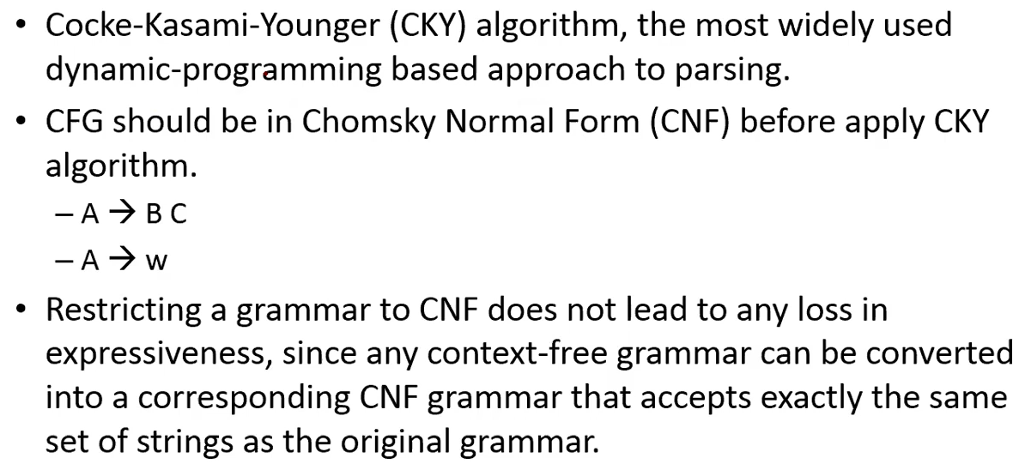
CKY Parsing: A Dynamic Programming Approach

Slide 31
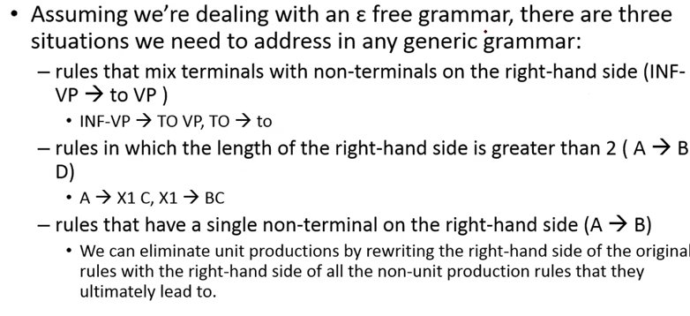
How to Convert CFG to CNF

Slide 32
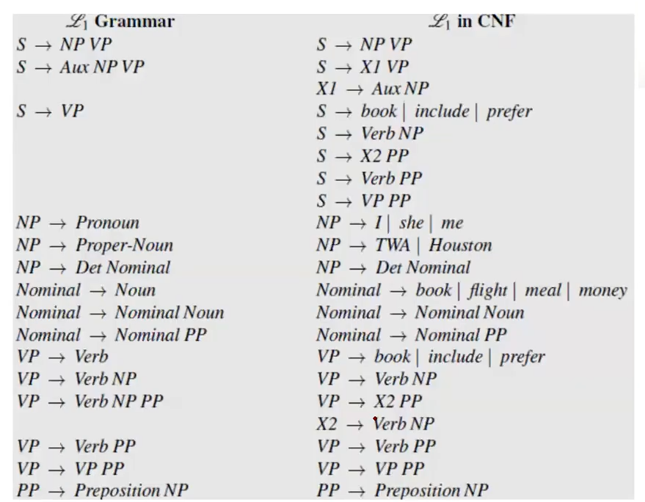

Slide 33
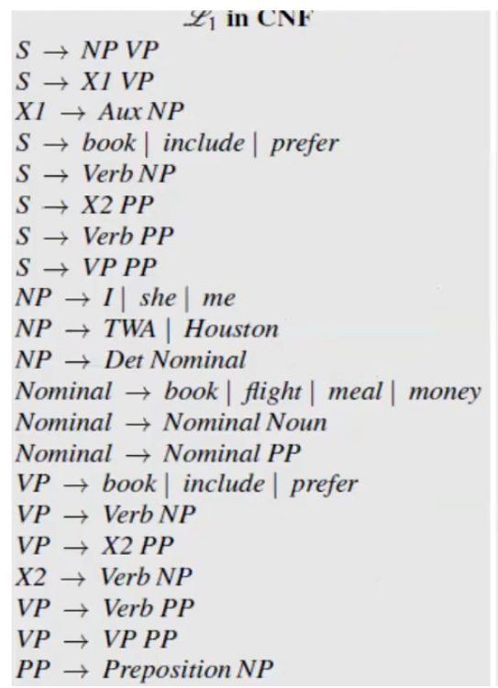
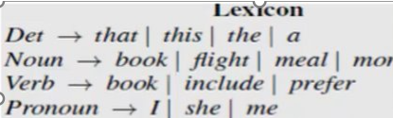
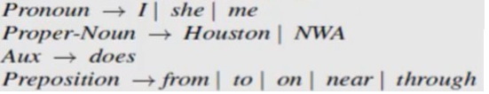


Slide 34
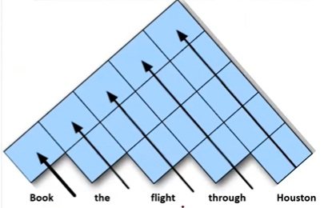
























CKY Algorithm

Slide 35
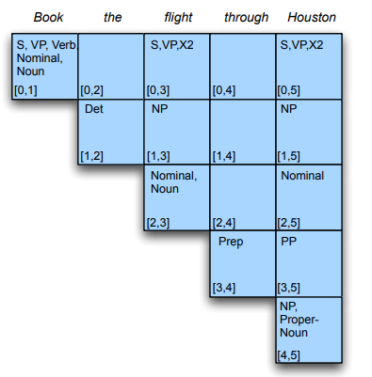

Slide 36
Cocke-Younger-Kasami Algorithm
It is used to solves the membership problem using a dynamic programming approach.
The algorithm is based on the principle that the solution to problem [i, j] can constructed from solution to subproblem [i, k] and solution to sub problem [k, j].
The algorithm requires the Grammar G to be in Chomsky Normal Form (CNF). Note that any Context-Free Grammar can be systematically converted to CNF.
This restriction is employed so that each problem can only be divided into two subproblems and not more – to bound the time complexity.

Slide 37
How does the CYK Algorithm work?
For a string of length N, construct a table T of size N x N. Each cell in the table T[i, j] is the set of all constituents that can produce the substring spanning from position i to j.
The process involves filling the table with the solutions to the subproblems encountered in the bottom-up parsing process.
Therefore, cells will be filled from left to right and bottom to top.

Slide 38
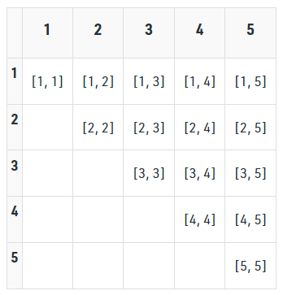
In T[i, j], the row number i denotes the start index, and the column number j denotes the end index.

Slide 39
The algorithm considers every possible subsequence of letters and adds K to T[i, j] if the sequence of letters starting from i to j can be generated from the non-terminal K.
For subsequences of length 2 and greater, it considers every possible partition of the subsequence into two parts, and checks if there is a rule of the form A -> BC in the grammar where B and C can generate the two parts respectively, based on already existing entries in T.
The sentence can be produced by the grammar only if the entire string is matched by the start symbol, i.e, if S is a member of T[1, n].

Slide 40
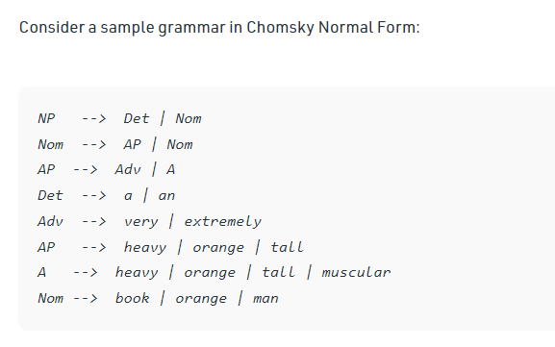

Slide 41
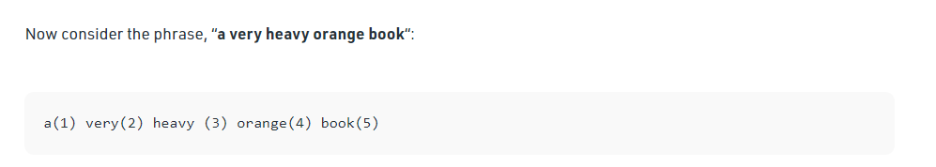
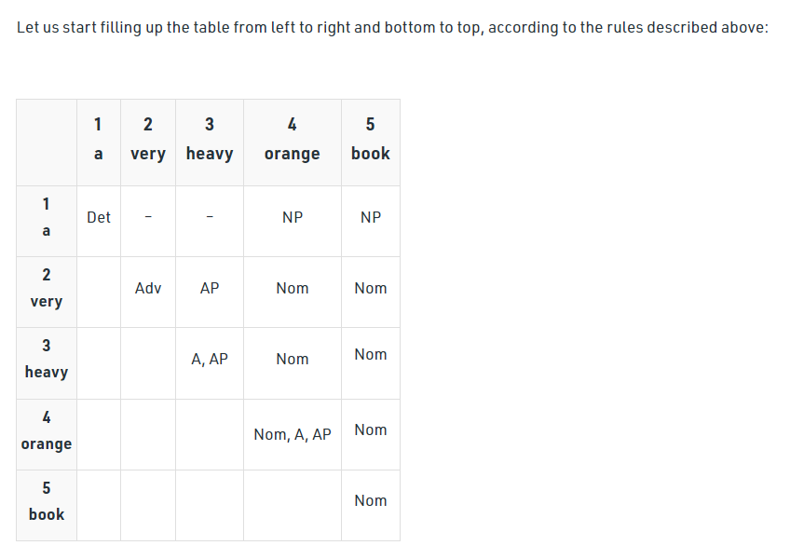

Slide 42
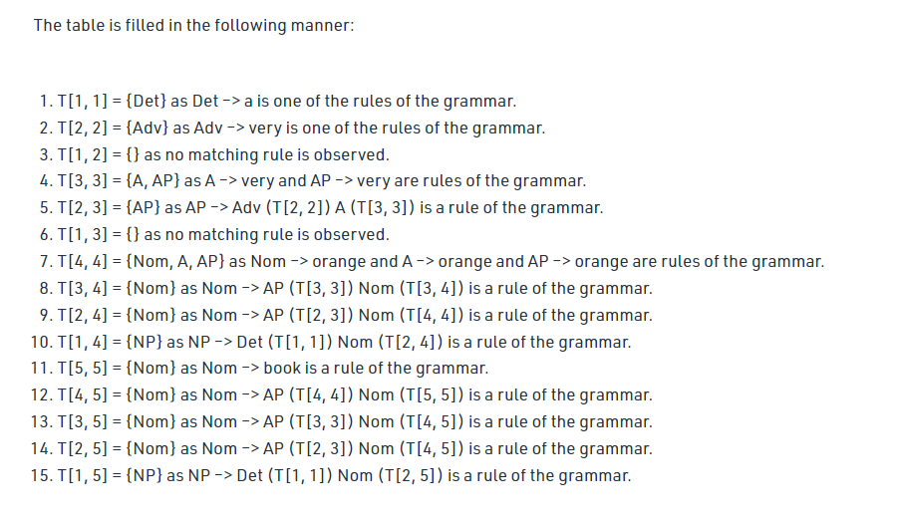

Slide 43
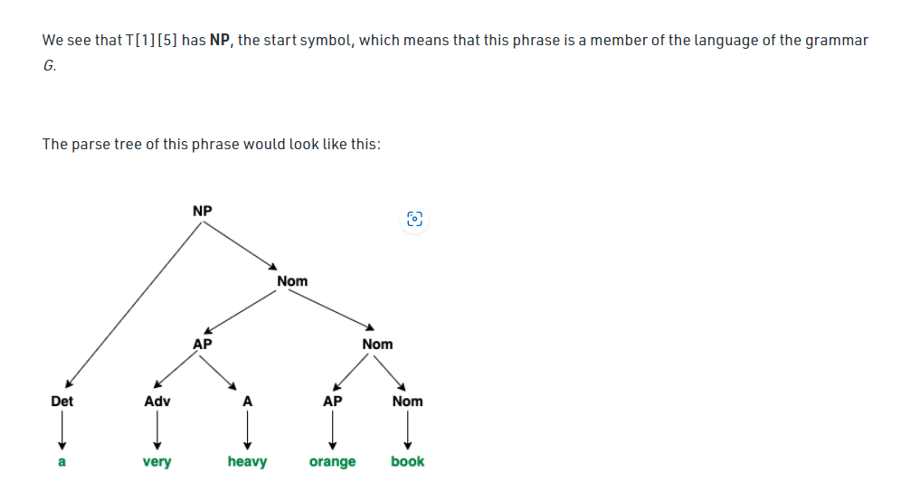

Slide 44
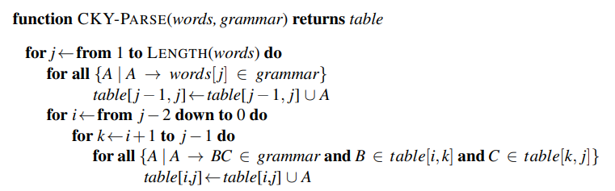
CYK Algorithm

